Slide 1

Intelligent Systems & Robotics
Kunal Gaurav (kg20952@essex.ac.uk)
CE801: Assignment

Slide 2
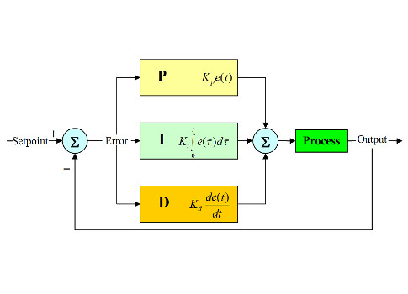
PID Controller
Proportional-Integral-Derivative (PID) control is the most common control algorithm used in industry and has been universally accepted in industrial control. The popularity of PID controllers can be attributed partly to their robust performance in a wide range of operating conditions and partly to their functional simplicity, which allows engineers to operate them in a simple, straightforward manner.
Block diagram of a basic PID control algorithm.

Slide 3
Parameter Tuning
I selected the parameters by some trial-and-error methodology.
Steps:
Started with a very small P coefficient
Initially I kept the I and D coefficient equal to 0
Then I increased the P coefficient until I saw some oscillation.
Then adjusted the value in the same way.
Parameter Choice
K_{p} = 2.0
K_{i} = 0.01
K_{d} = 0.2

Slide 4
Performance

Slide 5
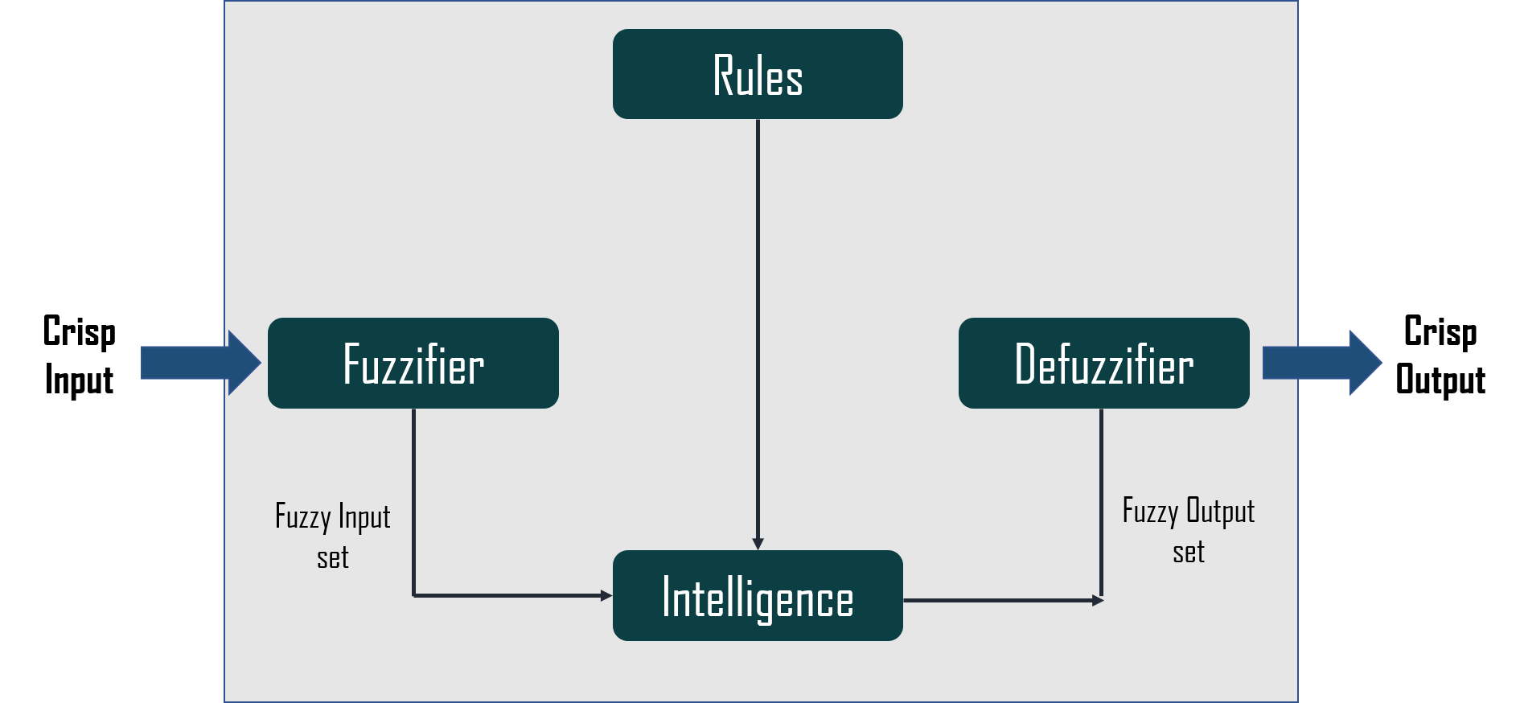
Fuzzy Logic Control System
A fuzzy control system is a control system based on fuzzy logic—a mathematical system that analyzes analog input values in terms of logical variables that take on continuous values between 0 and 1, in contrast to classical or digital logic, which operates on discrete values of either 1 or 0.

Slide 6
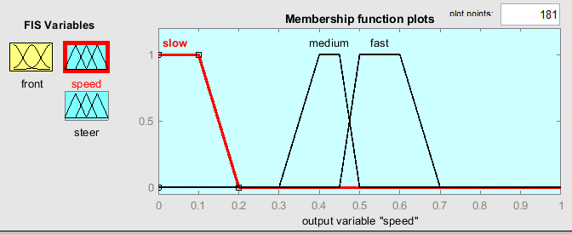
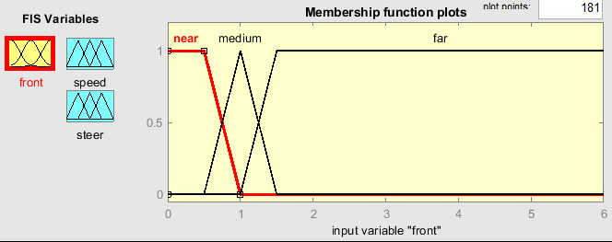
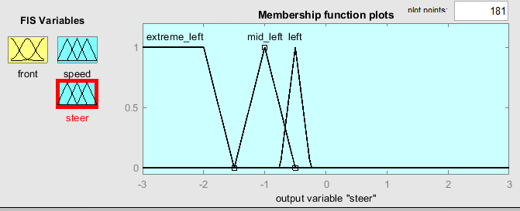
Membership Functions for Obstacle Avoidance

Slide 7
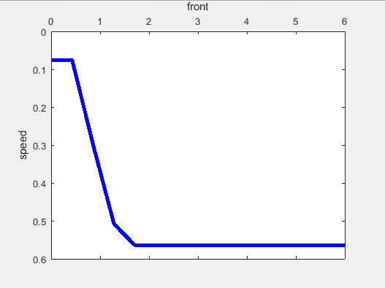
Surface Diagram

Slide 8
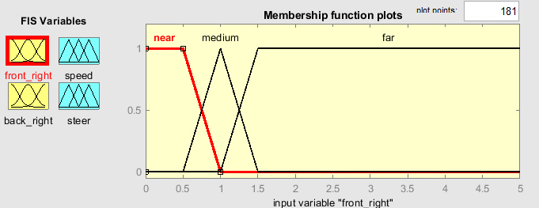
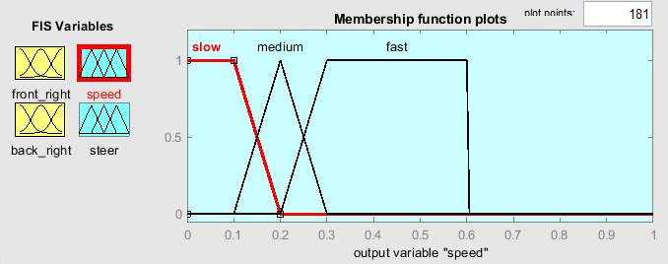
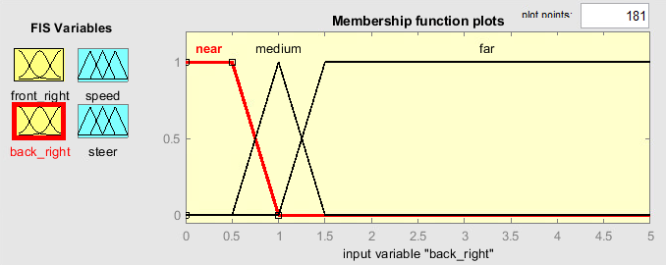
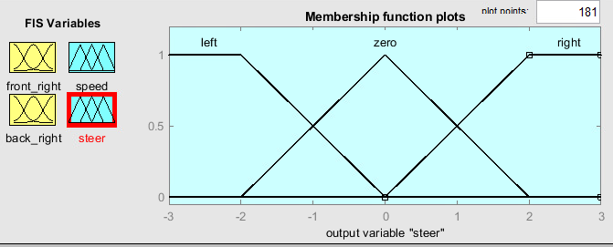
Membership RF

Slide 9
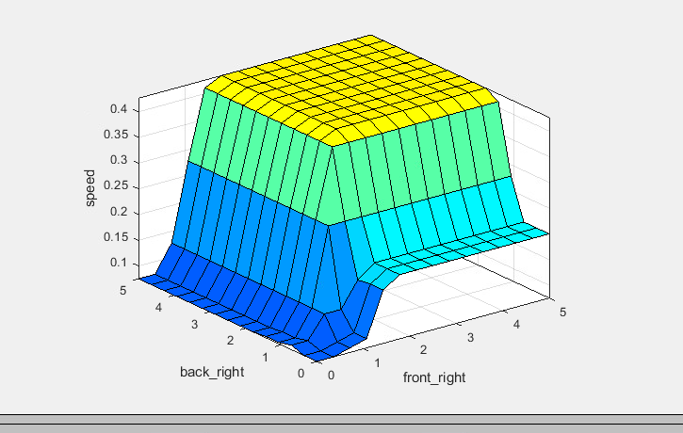
Surface Diagram of Right wall following

Slide 10
Behavior based control architecture

Slide 11
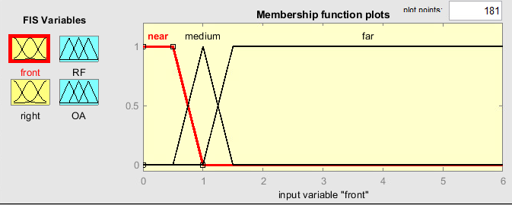
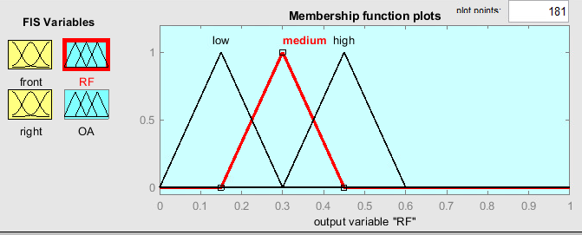
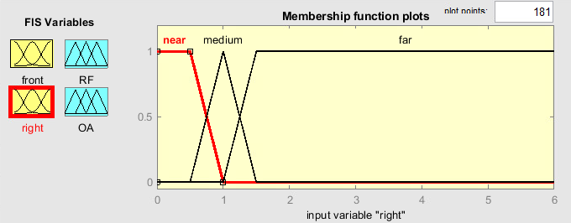
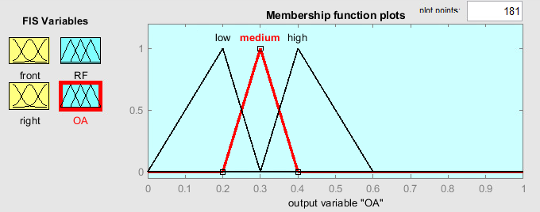
MF for Behavior

Slide 12
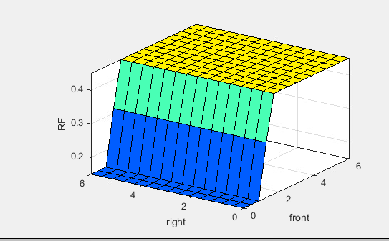
Surface Diagram for behavior

Slide 13
Robot Performance

